Slide 1
Exploring the Major Factors of Road Accidents in New York City (Team-Z)
Aafreen Shan Asmath
M.Sc Data Analytics
x23231335@student.ncirl.ie
Naveen Kumar Ramesh
M.Sc Data Analytics
x23103922@student.ncirl.ie

Slide 2
Dataset-1: Motor Vehicle Collision Crashes (Structured)
This dataset shows The number of 'Motor Vehicle Collision Crashes in New York city which indicates the date and time of car crashes as well as their locations, injuries or fatalities if any and causes of such collisions.
It contains 29 columns with information about borough, zip code, latitude followed by longitude points indicating the car crash street name or type to analyse collision trends for better road safety policies and strategies against accidents.
Data is taken from Data.gov which is a public website for governmental data published and maintained by the Us goverment.

Slide 3
Dataset-2: Motor Vehicle Collision Crashes person (Unstructured)
The second dataset “Motor Vehicle Collision Crashes – Person” contains the data of the people who were involved in the crash..
It has 21 columns including their crash date and time as well, their injuries and state of emotion, condition, sex.
Data is taken from Data.gov which is a public website for governmental data published and maintained by the the Us goverment.

Slide 4
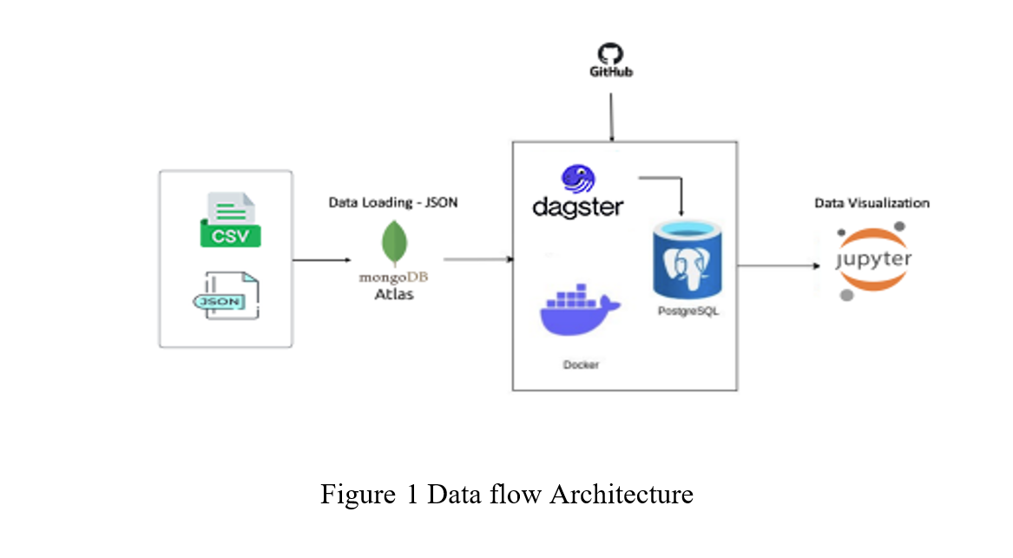

Slide 5
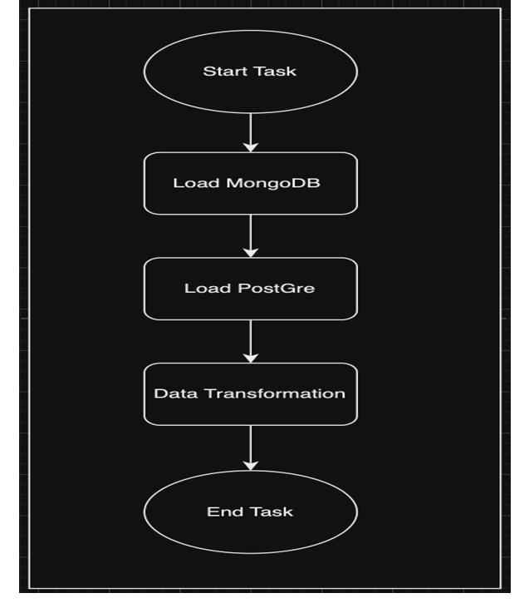

Slide 6
Conclusion:
Based on the study of the datasets Motor Collisions – Crashes and Motor Collision – Person, combined with the analysis of the data, we can able to get valuable insights and new perspectives on the control and reduction of road accidents or crashes happening in the year till 2023 in New York City. Our data analysis show that the Mature people with ages categorized from 35-45 years where the main group of person facing road accidents with having a injury on the head or neck when they were on the driver role or full body injury when they were in in the co-passenger role.
By implementing suitable traffic rules depending the season, where there will be an increase in the road accidents and also creating awareness among the people with the category of Mature people of the effects of the accidents occurring in the city, which will automatically reduce the number of accidents by half in a year. As the type of vehicle facing most number of crashes per year was Sedan, can equipped with further safety features and speed control mechanism which also plays a huge part in reduction of the road accidents. Furthermore, the future analysis of this area, may require additional datasets including relevant details on the neighboring cities with cross data analysis and a update on the gathering of updated data in these recent time. With these updated data and insights, developing a machine learning model will also be a better help in predicting the major factor and thus by reducing the future crashes.

